Slide 1

Life as an LGBT person in Europe
A view of the results of the
2012 European Union lesbian, gay, bisexual and transgender survey
conducted by the European Union Agency for Fundamental Rights

Slide 2
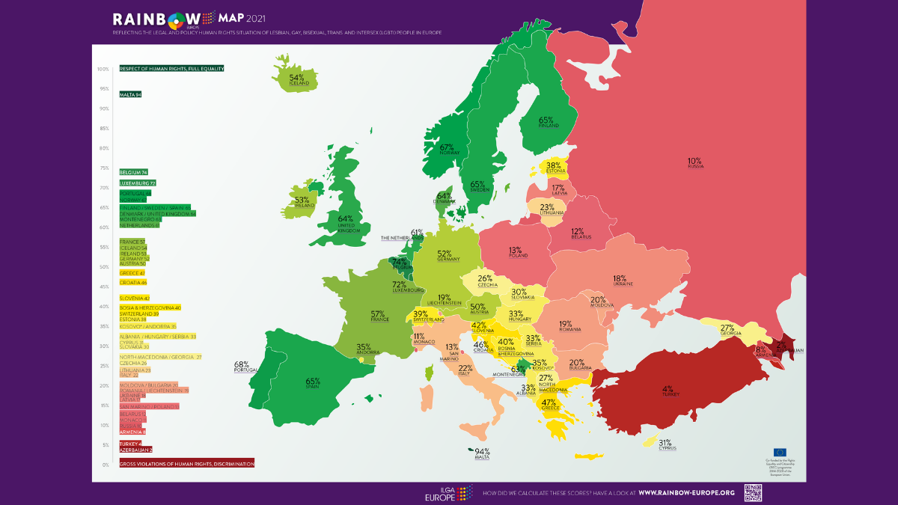
A survey? But… why?
There is already data about LGBT rights in Europe, look:
ILGA Europe compiles a map each year of the status of LGBT rights in each country in Europe.
Notes:
You may ask why a survey.
ILGA Europe already procudes an overview of LGBT rights per country in the EU each year.
That’s truly great, and very useful for EU policy makers, human rights, activists, etc.
But what was missing was was the human side. People’s experiences and perception.

Slide 3
LGBT rights are very important, but don’t tell the whole story.
Current data doesn’t show people’s experience and perception.
The EU LGBT survey was set-up to answer those questions, and provide policy makers with the needed data to develop their work.
Notes:
Survey to answer questions like:
Do LGBT people feel:
Comfortable being their authentic selves in daily life?
Treated equally?
Or even safe?

Slide 4
The survey:
Conducted online
Self selected sample
Promoted via LGBT specific media, LGBT associations, online groups, dating apps, social media.
93,079 respondents
From 28 EU countries

Slide 5
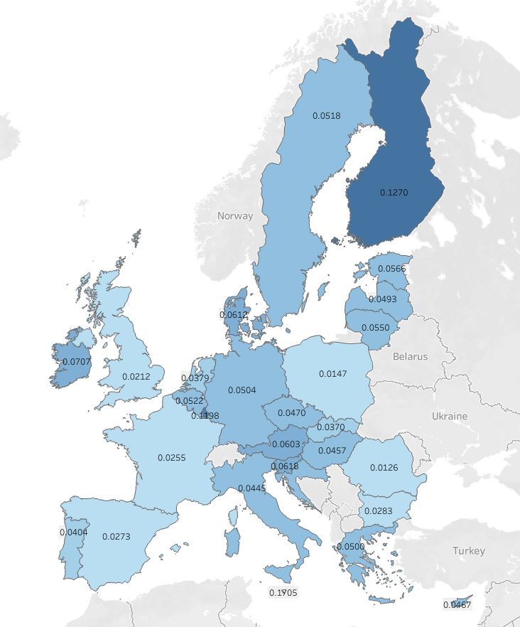
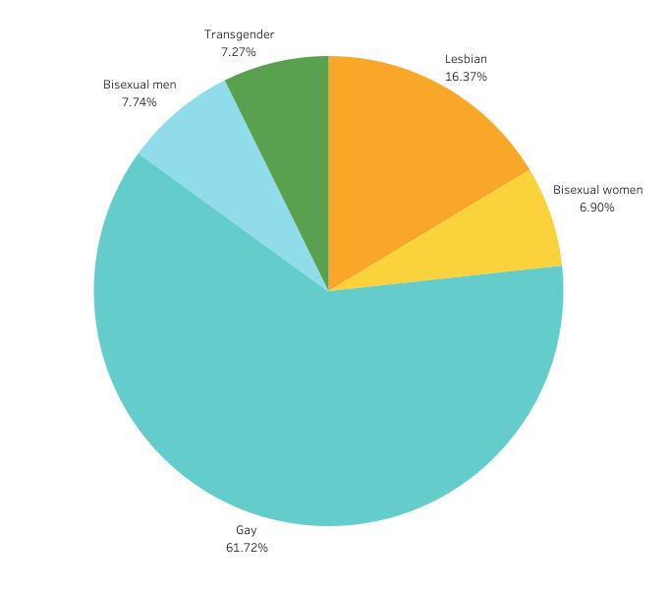
The respondents (per country and subset)
Notes:
Findings:
Malta, Finland and Luxembourg are highgly respresented with more than 0.1 % of the population participating in the survey.
In 8 countries less than 0.04% of the population participated.
There is no correlation between the situation of LGBT people in a country and low participation.
Yes, I made a pie-chart! Because expectation was 50/50 balance between men and women.
But this highlights the inbalance in the survey sample, where men (gay men specifically) are overly represented.
Unfortuantely we don’t have any other data, so we have to use what is available.

Slide 6
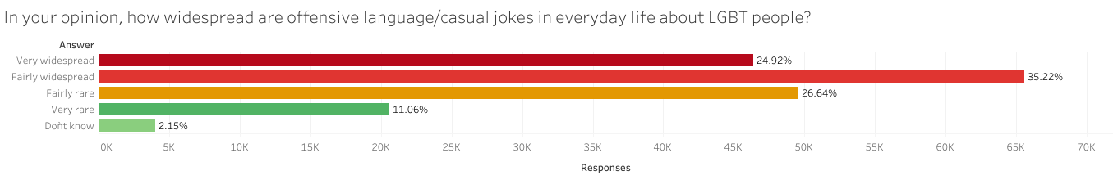
Let’s look at some results.
Words do matter.
So what do people hear in everyday?
Notes:
Casual jokes are not funny, and offensive language does hurt.
25% of resopndents think it’s very widespread. And 60% of all respondents think it is fairly to very widespead.
Another 25% think it’s farly rare, which is better. But even hearing “fairly rarely” cruel jokes about your peers has an impact on people.

Slide 7
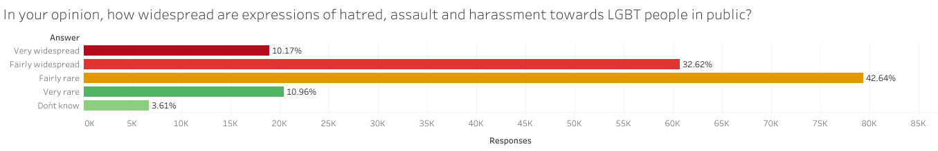
How about expressions of hatred, assault and harassment in public?
For 42% of the respondents, expressions of hatred, assault and harassment are fairly to very widespread in public.
Notes:
Offensive language and casual jokes are widespread, but what about actual expression of hatred, assault and harassment?
It’s not as bad, but still shockingly common to hear!

Slide 8
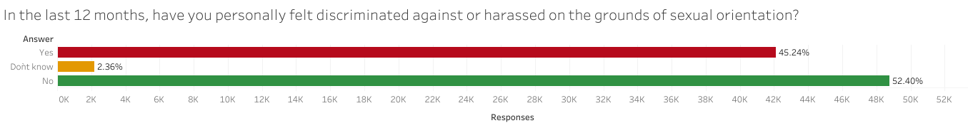
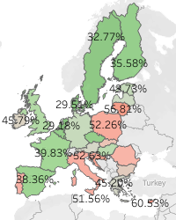
Is discrimination common?
Nearly half of the respondents have felt discriminated against on the grounds of their sexual orientation.
Looking at the differences per country, we can see some areas that are more problematic.
Notes:
Discrimination can range from being refused service (cabs in Amsterdam) to being passed on for a promotion at work, etc. This happened to 45% of the respondents in the last year (prior to the survey).

Slide 9
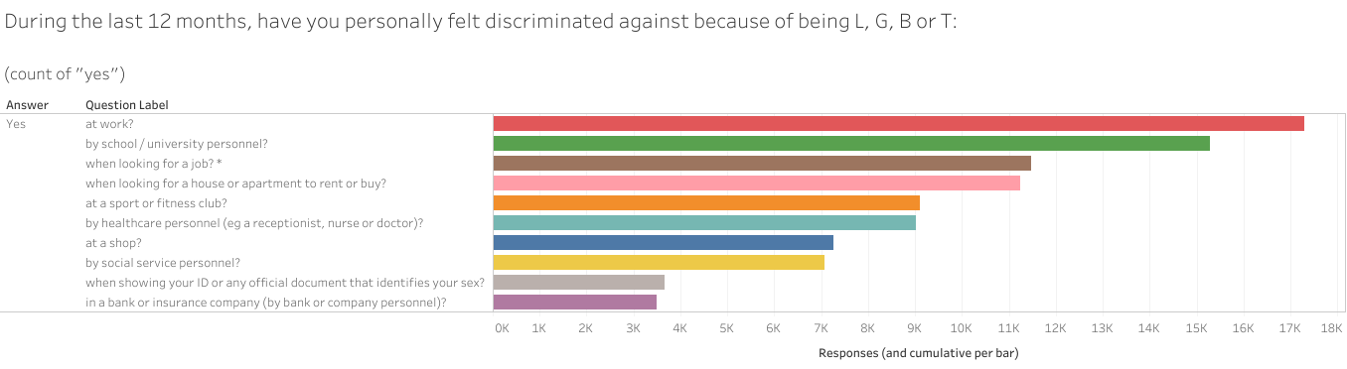
Where have respondents felt discriminated against?
We can see that work and school are two situations where discrimination is at its highest.
Notes:
We can also see that people can be discriminated against in more than one are of their life. This got me curious, so I checked again the cumulative discrimination per country…

Slide 10
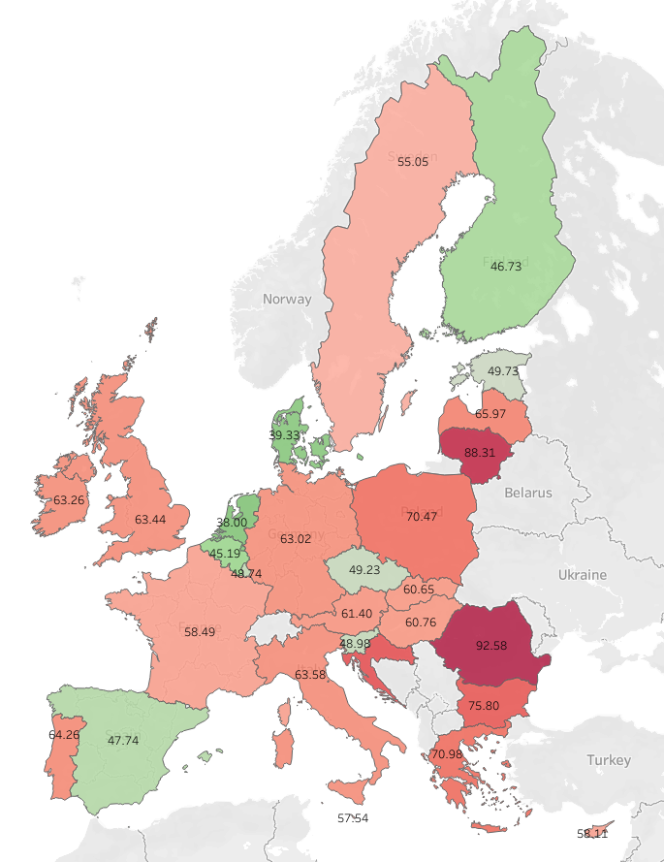
What does adding up the instances of discrimination mean on country level?
The overall situation looks worse, and the differences per country are significantly higher.
Notes:
Adding up the instances of discrimination paints a much grimmer picture, with some countries reaching almost 100% of instances of discrimination per respondent.

Slide 11
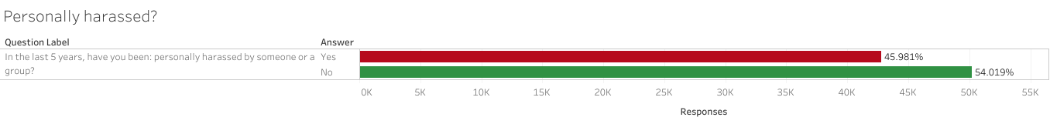
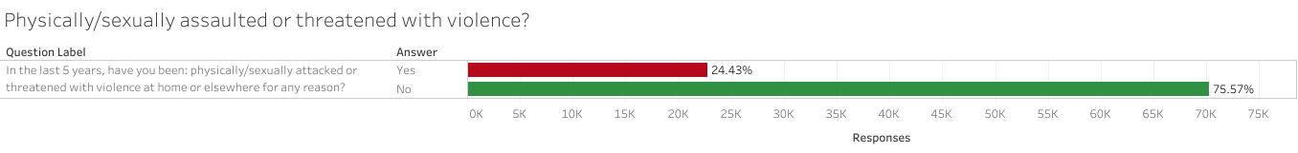
What about direct assaults or threats?
In the last 5 years, have you been…
While 45% of respondents have been personally harassed at east once in the last 5 years, the figure drops to 24% when refering to actual assault or threats of violence.
Still, 1 in 4 LGBT person in the EU has been faced with assault or threats of violence.
Notes:
We are no longer talking about being offensive language, or being discriminated against, but about being directly attacked simply for being who you are.

Slide 12
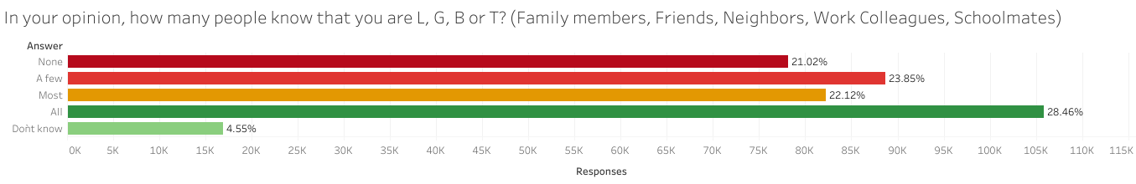
Given the issues, can respondents be open about being LGBT?
When being LGBT comes with so much negativity or even violence, some people have to hide. For 44% of respondents this means they cannot be themselves around all/most people.
Notes:
Let’s remember here that being ”out” doesn’t mean running around all day with a giant gay flag. It simply means that you don’t have to lie to your co-workers or family about what you’ve done on the weekend, or not having to lie about who you share your life with.
So yes, being out or not is important, and can have a great impact on quality of life.

Slide 13
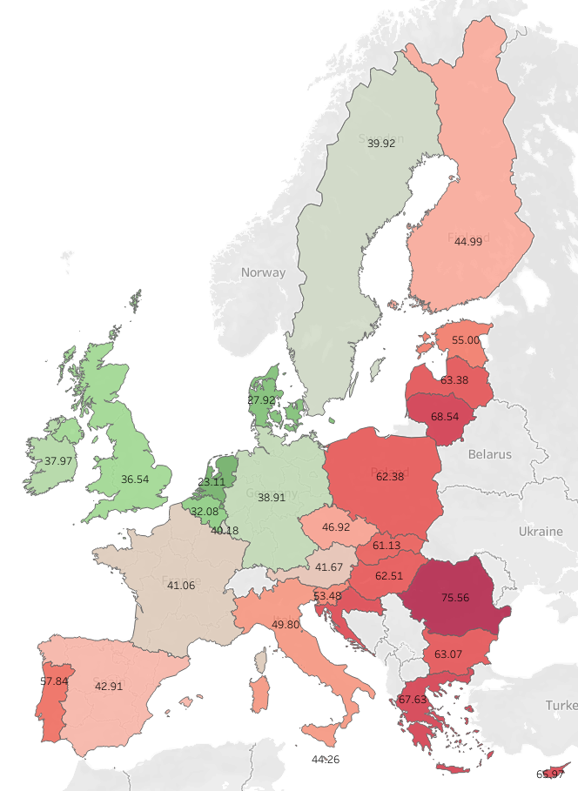
Being open or not, how does that differ per country?
There are visible differences between countries. While there is some correlation with countries with higher discrimination, it is not directly correlated.

Slide 14
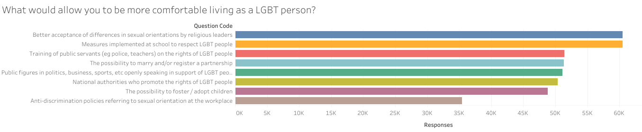
So… what now?
With a more in depth knowledge of the situation, we can effect change! The respondents strongly agree that the following would be useful:
Something everybody can do is be an active ally. Call people out if they use offensive language or ”jokes”, speak up when we see discrimination, etc.

Slide 15
Questions? Remarks?

